Slide 1
Cell Prediction Walkthrough
Brian Anderson, MS

Slide 2
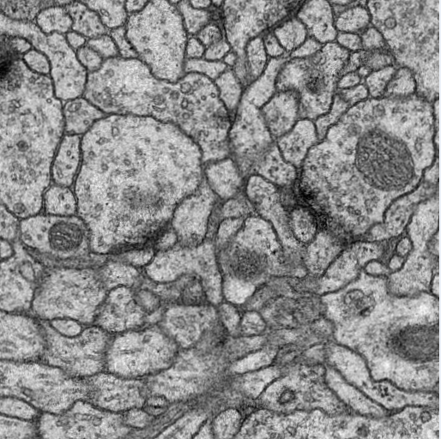
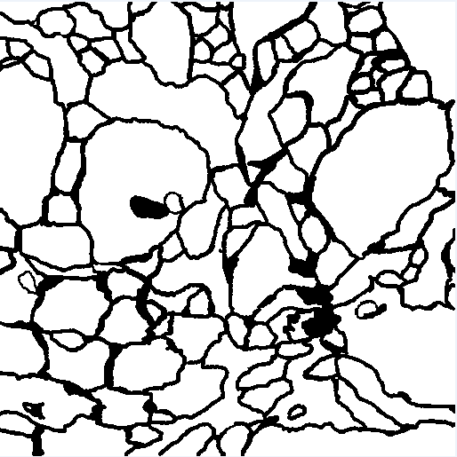
Loading training data
Source Information
Source | Training | Testing
ISBI Challenge* | 30 | 30
Augmentations | 60 | 30
Image
Label
* http://brainiac2.mit.edu/isbi_challenge/

Slide 3
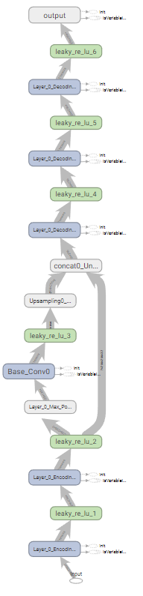
Creating model
The ‘Shallow net’
Maybe more familiar
Max Pooling
Up Sampling
Layer_0 Encoding
Base
Layer_0 Dencoding

Slide 4
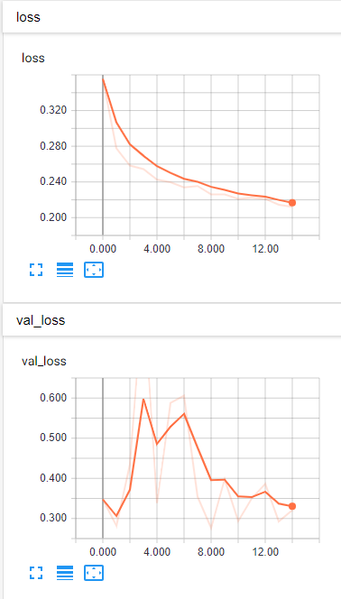
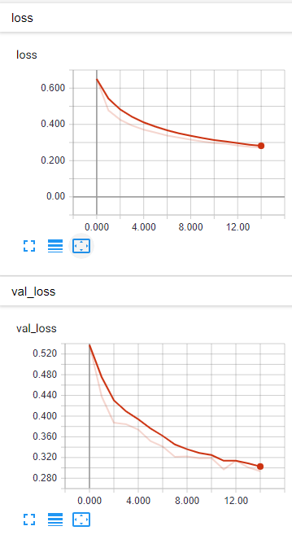
Hyper parameters
Lr = 0.1
Lr = 0.001
Learning rate
Number of epochs
Steps_per_epoch
Loss_function
Batch_normalization

Slide 5
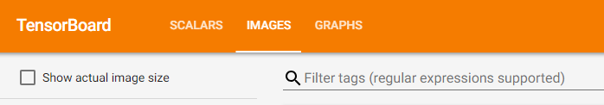
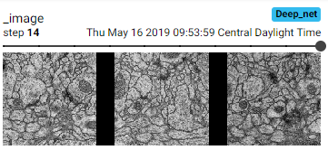
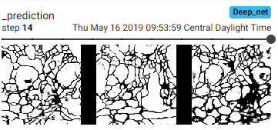
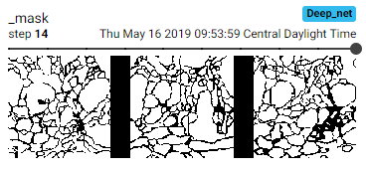
Visualize results

Slide 6
Try things out
Add/remove layers, change number of filter banks
Change learning rate, try without batch_normalization
See who can make the best model!

